Slide 1
Traffic Flow Prediction for Road Networks Using Deep Learning
UZUM STANLEY

Slide 2

1
Background
2
Problem Definition
CONTENTS
3
Proposed Deep Learning Solution
4
Data Selection
5
References

Slide 3
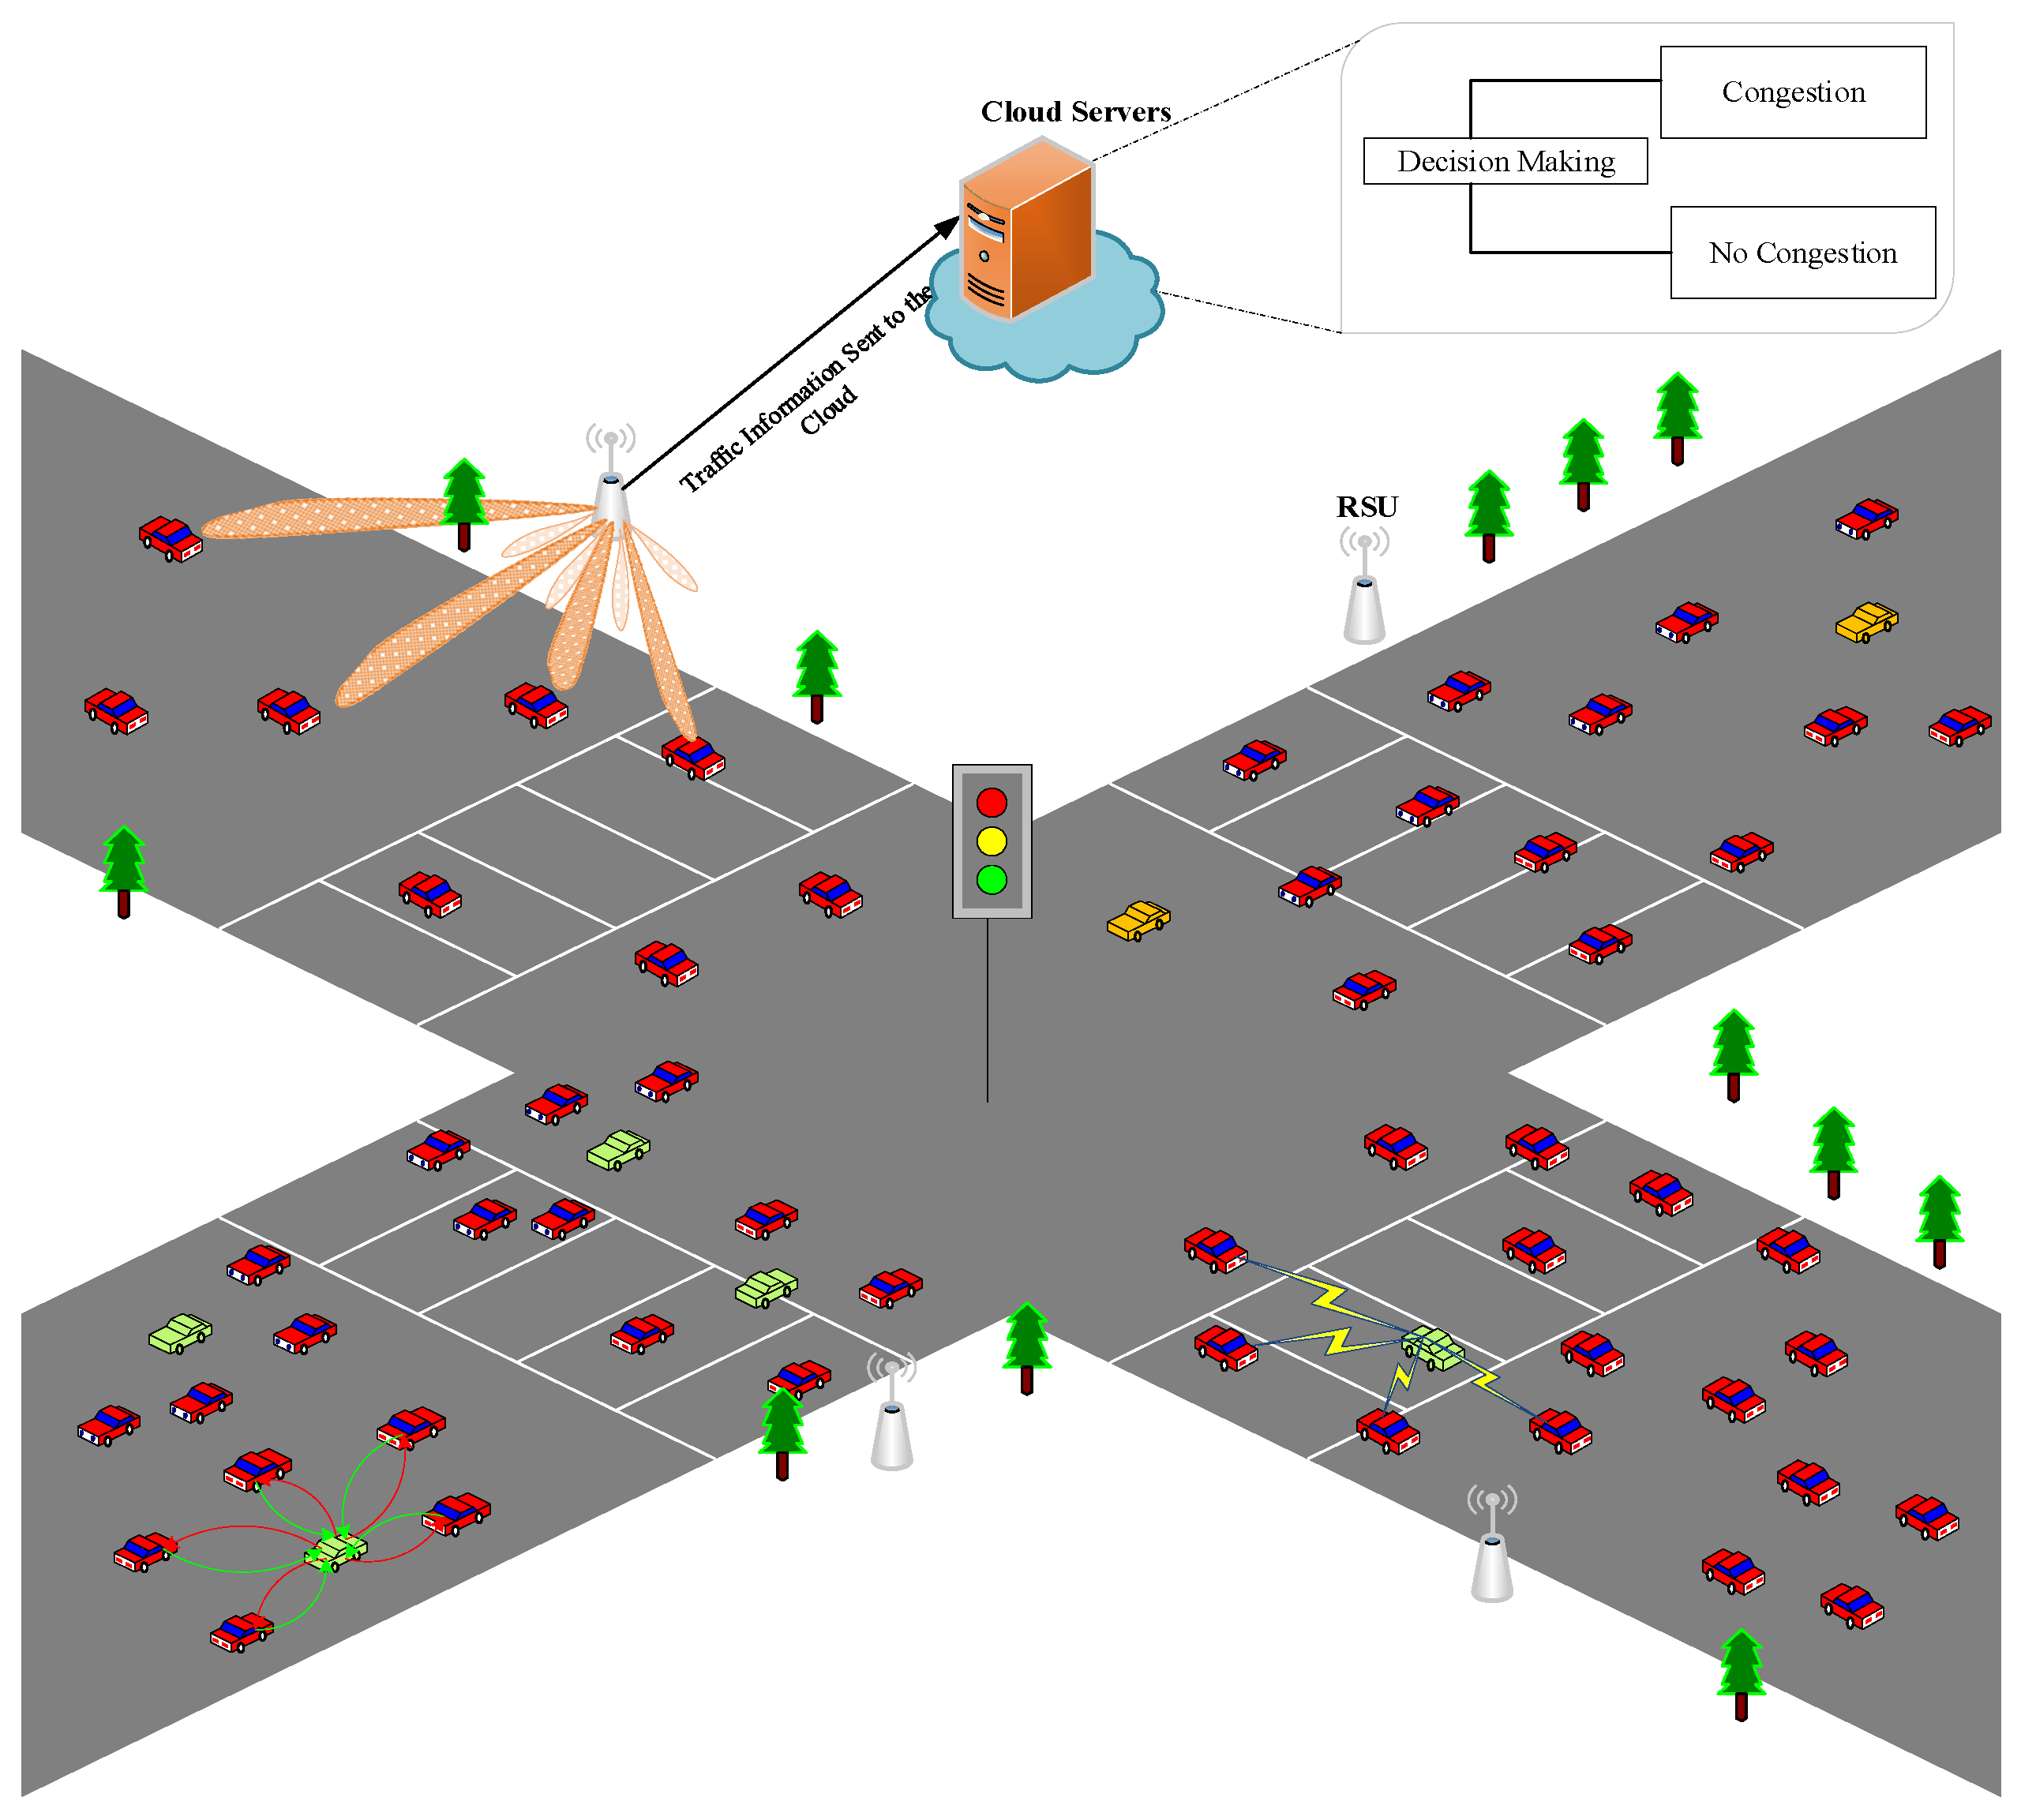
1
Background
Traffic congestion is a pervasive issue in urban areas,
impacting travel time, fuel consumption, and overall
quality of life. As cities grow, managing traffic
becomes increasingly challenging. Accurate traffic
flow prediction is essential for efficient traffic
management, route planning, and infrastructure
development.
Accurate traffic flow prediction is vital for urban transportation,
mitigating congestion and improving environmental and urban
life quality.
Embracing innovative predictive analytics methodologies and
leveraging emerging technologies can empower cities to
confront the challenges posed by traffic congestion and
forge a path towards more sustainable, resilient, and livable
urban futures.
Add your words here.according to your need to draw the text box size.Please read the instructions and more work at the end of the manual template.

Slide 4
Traffic Flow Road Networks
1
Traffic Flow Prediction, a form of time series prediction, forecasts future traffic patterns and congestion levels based on historical data analysis of traffic flow, aiding in urban transportation management and congestion mitigation through informed decision-making.
The historical traffic data, which consists of vehicle counts, speeds, congestion patterns, and other relevant factors collected over time, forms a time series dataset.
This project employs advanced deep learning methodologies, including long short-term memory (LSTM) networks, convolutional neural networks (CNNs), Custom Model, Gated Recurrent Unit (GRU), and Multilayer Perceptron (MLP). It aims to analyze a dataset spanning four junctions to develop a predictive model for traffic flow patterns.

Slide 5
2
Problem Definition
The specific problem i intend to address within the domain of deep learning is traffic congestion problem
by providing an intelligent system to predict, manage, and alleviate congestion.
better understanding of traffic patterns will help in building an
infrastructure to eliminate the problem.
Safety
Real-time traffic flow predictions aid in preventing accidents and improving road safety. Timely rerouting can avoid hazardous situations.
Traffic Efficiency
Accurate predictions enable cities to optimize traffic flow, reduce congestion, and enhance overall transportation efficiency. Commuters benefit from shorter travel times and reduced stress.
Emergency Response
During emergencies (e.g., accidents, natural disasters), accurate predictions help emergency services allocate resources effectively.
Infrastructure Planning
Predictive models inform infrastructure development, such as road expansions, traffic signal optimization, and public transportation enhancements.
Environmental Impact
Efficient traffic management contributes to lower emissions and a greener environment. Predictive models can guide policies for sustainable urban planning.
Economic Productivity
Smooth traffic flow supports economic activities by ensuring timely goods delivery, reducing business costs, and promoting commerce.

Slide 6
3
Proposed Solution
Long Short-Term Memory (LSTM) Networks
Purpose: Capture temporal dependencies in traffic data.
Applications:Traffic flow prediction, Dynamic signal control.
Convolutional Neural Networks (CNNs)
Purpose: Analyze spatial features (e.g., camera images).
Applications: Traffic image analysis (vehicle detection, anomaly detection), Real-time event detection.
Custom Model
Purpose: Flexibility to design tailored architectures.
Applications: Traffic prediction with external factors (weather, events), Congestion classification.
Gated Recurrent Unit (GRU)
Purpose: Similar to LSTM but computationally lighter.
Applications: Short-term traffic prediction, Traffic state estimation.
Multilayer Perceptron (MLP)
Purpose: Versatile feedforward network.
Applications: Traffic demand modeling, Route optimization.
Model Architectures

Slide 7
4
Data Selection
This dataset contains(48120) observations of the number of vehicles each hour in four
different junctions: https://www.kaggle.com/datasets/
fedesoriano/traffic-prediction-dataset/data
1) DateTime
2) Juction
3) Vehicles
4) ID
DateTime
FOCUS
Traffic Prediction Dataset
Hourly traffic data collected from four distinct junctions provides valuable insights for transportation analysis.
Junction
TEXT
Vehicles

Slide 8
4
Feature Engineering:
Creating relevant features enhances prediction accuracy:
Lagged traffic flow values:
* Previous time steps provide context for predicting future flow.
Weather conditions:
* Temperature, precipitation, and other weather-related features impact traffic.
Temporal factors:
* Day of the week, holidays, and special events influence traffic patterns.

Slide 9
4
Model Evaluation and Hyperparameter Tuning
It's important to ensure the quality, consistency, and relevance of the data sources selected for model training
and testing. Data preprocessing steps, such as handling missing values, outlier detection, and feature
engineering, are essential to prepare the data for deep learning model training.
Additionally, privacy and data security considerations should be addressed
when accessing and utilizing sensitive data sources
such as GPS traces or traffic camera feeds.
Split the data into training, validation, and test sets.
Evaluate model performance using metrics like Mean Absolute Error (MAE) or Root Mean Squared Error (RMSE).
Fine-tune hyperparameters to optimize model performance.

Slide 10
5
References
Lv, Y., Duan, Y., Kang, W., Li, Z., & Wang, F.-Y. (2015). Traffic flow prediction with big data: A deep learning
approach. IEEE Transactions on Intelligent Transportation Systems, 16(2), 865-873.
Xiaochus. (n.d.). TrafficFlowPrediction. Retrieved from https://github.com/xiaochus/TrafficFlowPrediction
https://www.kaggle.com/datasets/fedesoriano/traffic-prediction-dataset/data

Slide 11
Any Question

Slide 12





THANNK YOU

